Slide 1
MCLA ATHLETICS

Slide 2
3-2-1 VISION

Slide 3
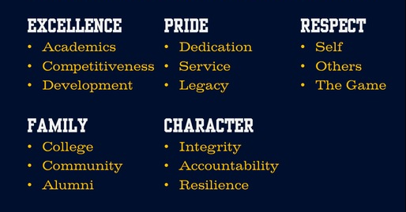
MCLA ATHLETIC VALUES

Slide 4
STUDENT-ATHLETE EXPECTATIONS
Support the Athletic Department Vision & Values
Positively represent the Department & College
Adhere to Team, Department, College & NCAA regulations
Lead by example
Strive for academic & athletic excellence
Exhibit sporting behavior at all times
Respect peers, coaches and athletic staff

Slide 5
CONFERENCE AFFILIATIONS

Slide 6
HIGHLIGHTS
4 Full Time Administrators
12 Full Time Coaches
Full Time Strength & Conditioning Coach & Athletic Trainers
Trailblazer Success Academic Program
Highest Retained Student Population on campus
Higher Graduation Rate than general student body

Slide 7
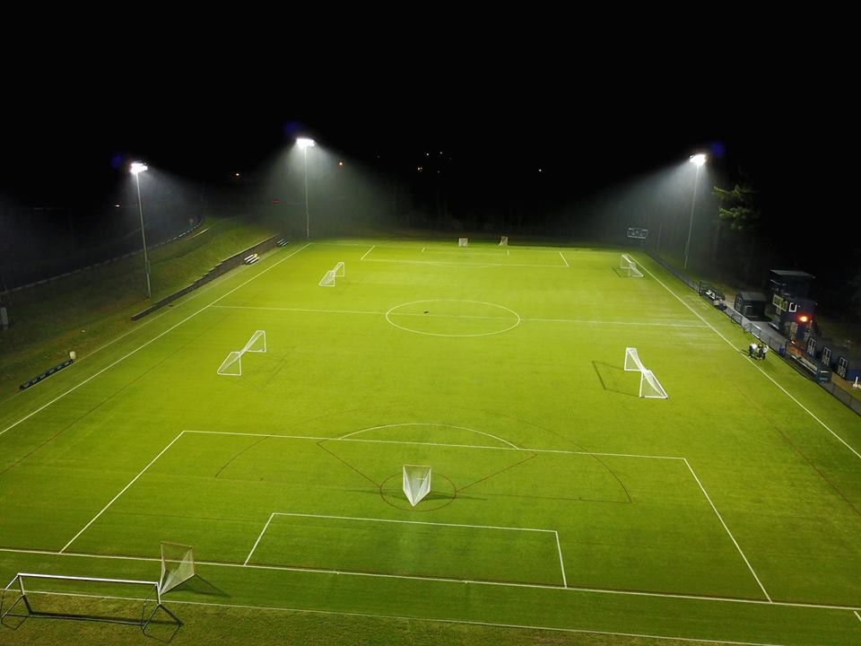
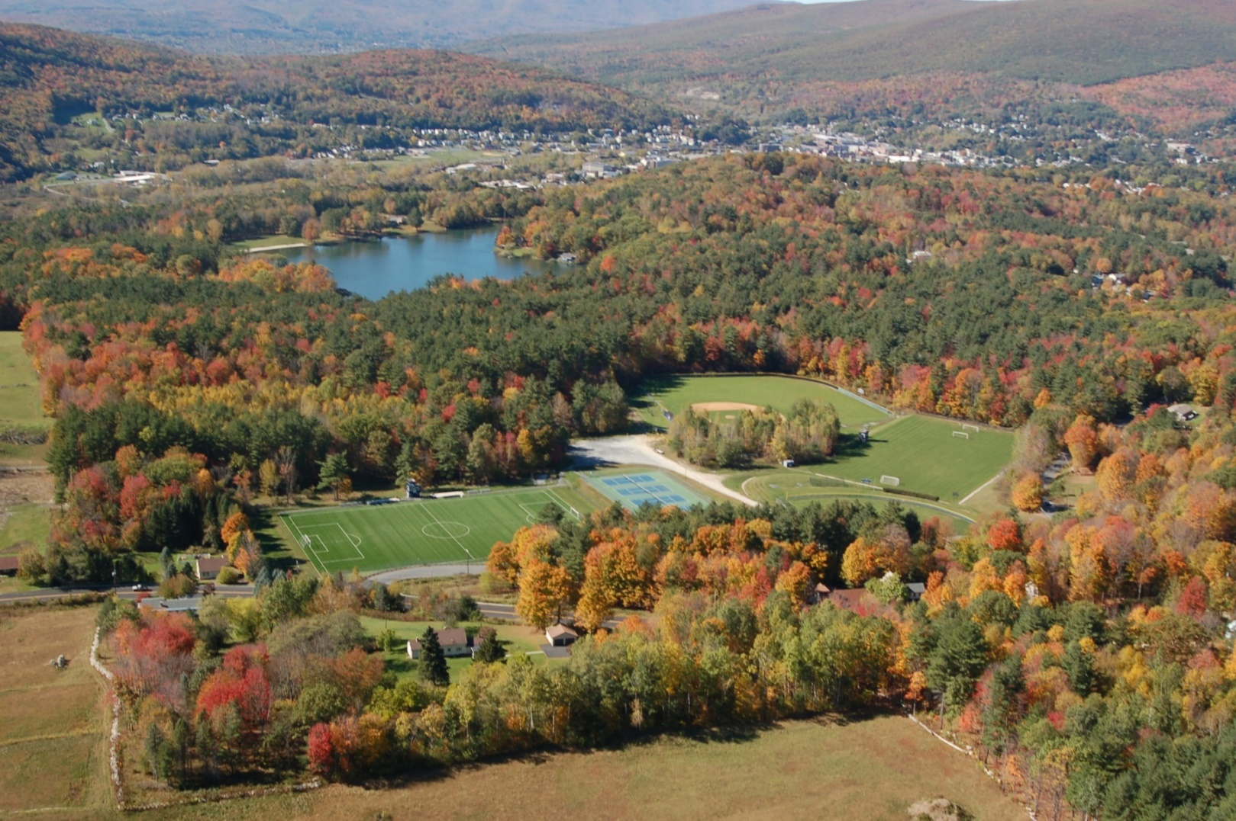
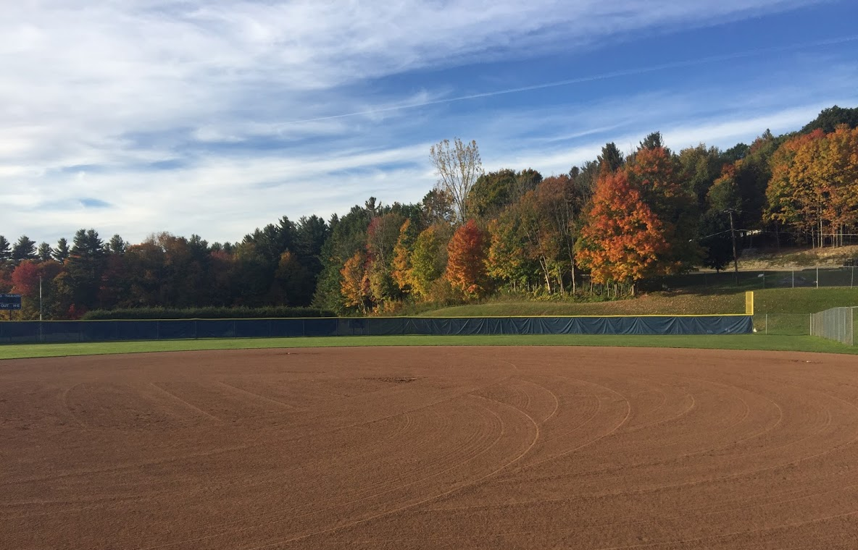
FACILITIES

Slide 8
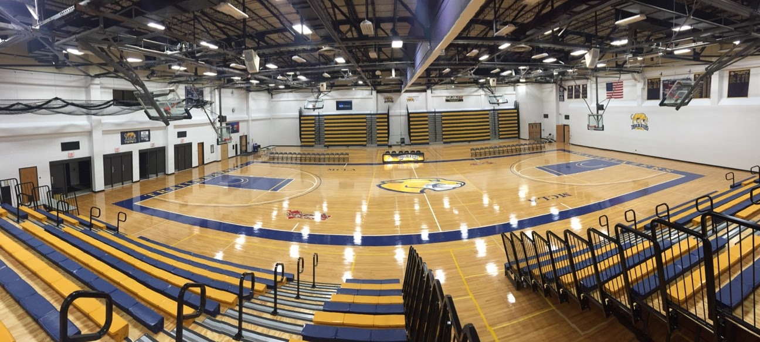
HOME OF THE TRAILBLAZERS

Slide 9
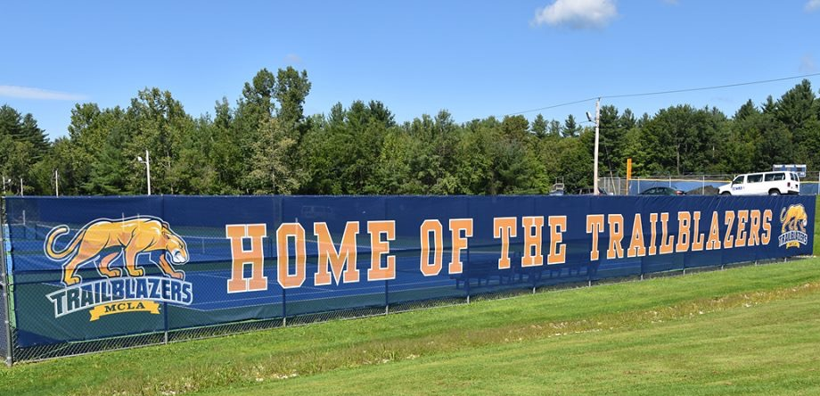
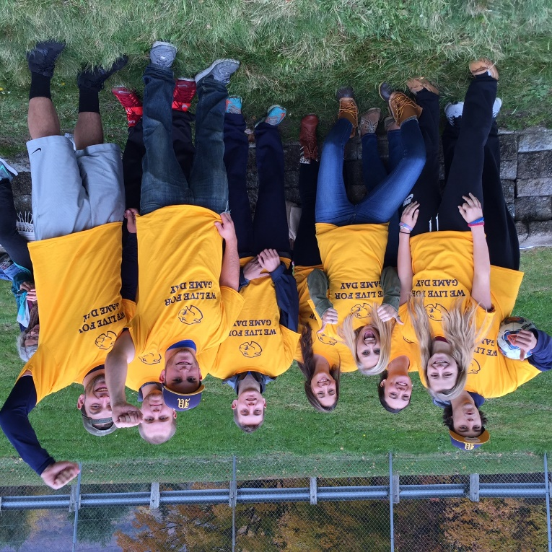
TRAIBLAZERPRIDE

Slide 11
QUESTIONS?
CONTACT US! WWW.ATHLETICS.MCLA.EDU
Don’t forget to follow us on social media
@MCLAAthletics
MCLA Athletics

