Slide 1
Welcome New Students!

Slide 2
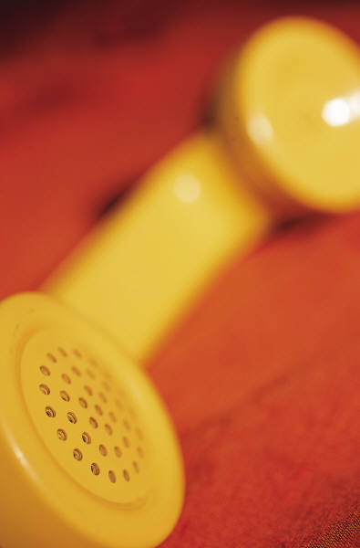
Campus Police Headquarters Emergencies Only
Located Dial – (413) 662-5100
277 Ashland Street or
Operates 24/7/365 Extension 5100
Non-emergencies or
Dial or Extension 911
(413)-662-5283 or 5284 From on Campus Phone

Slide 3
All Officers of the Department are: - Sworn / Armed Police Officers - Police Academy Trained - Certified First Responders – CPR/AED, Narcan - Receive Yearly In-service Training (State & Municipal) - Have Areas of Specialty Training: Emergency Medical Technicians, Field Training Officer, Defensive Tactics, Criminal Investigations, Evidence/Property Control, Fire Safety Educator

Slide 4
While we are Massachusetts Special State Police Officers, we are a proprietary police department responsible for the safety, security and protection of our campus community.

Slide 5
MCLA campus and resident areas are patrolled by Campus Police Officers on foot, bicycle and in a cruiser, 24 hours a day/year round. With 24 hour coverage, we are able to provide assistance at anytime for the following emergencies: - Any problems related to health, safety or the protection of life and property (Fire and Medical Emergencies, Crimes in Progress) - Major maintenance problems when maintenance staff can not be reached

Slide 6
The Campus Police Department also offers the following programs and services:
Fire Safety Education - Van Driver Education
Issuing of Student Identification Cards
Self Defense Education
Contact Point for Non-Emergency Related Medical Transports
Motor Vehicle Lockouts
Accompaniment (Escort) Service
Issuing of Parking Decals
Lost and Found

Slide 7
We Encourage you to practice safe behavior
- Don’t Walk Alone (escort, group…)
- Situational Awareness (be aware of your surroundings, location of emergency blue lights…)
- Take advantage of available technology (Guardian phone App)

Slide 8
Safety Is Everyone’s Responsibility!
SAFETY AND SECURITY INFORMATION
At Massachusetts College of Liberal Arts (MCLA), we try to take every possible step to ensure the safety and security of all our students, faculty and staff.
Crime is a national problem and from time to time, it even affects rural environments such as the one in which MCLA is located.
MCLA and its Campus Police Department strongly recommend you never take your safety for granted and adopt, adhere to, and practice safe behaviors at all times… whether on or off campus!
If You See Something Say Something

Slide 9
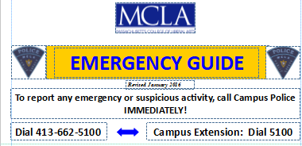
- Emergency Preparedness
- Public Information Log
- Lockdown Drills
- Fire Drills
- Feedback Complaint/Suggestion Form
- Security and Fire Safety Report (Clery)
Visit us at - http://www.mcla.edu/Student_Life/publicsafety/index

Slide 10
Emergency Notification and Timely Warnings RAVE Alert - In order to send you (info from us to you) emergency voice and text messages via your cell phone, you must provide MCLA with your mobile phone information (BANNER). For the GUARDIAN (info from you to us) you are asked to download the APP to your phone and add your profile. https://techhelp.mcla.edu/index.php/Rave/Guardian_Instructions The information you supply is confidential, will not be shared, and will be used to contact you through the system in the event of an emergency.

Slide 11
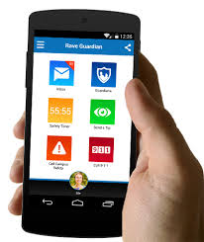
Guardian Phone Application - Call Campus Police (GPS and Profile), Call 911, Send Anonymous Tip, Safety Timer (who will be your Guardian?), Emergency Blue Light in the Palm of your Hands. - Information IN from YOU to US

Slide 12
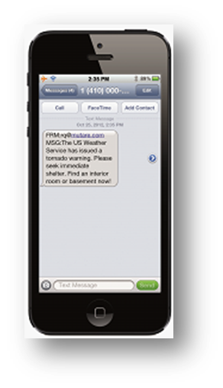
RAVE Alert System - Information OUT from US to YOU - Cell Phone in the Banner System - Receive Emergency Notifications - Text - E-mail - Cell Phone

Slide 13
Meet Your Campus Police Department

Slide 14
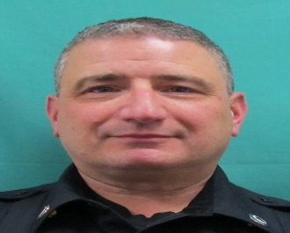
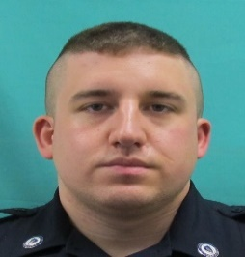
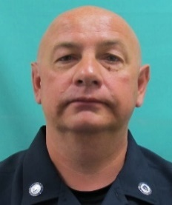
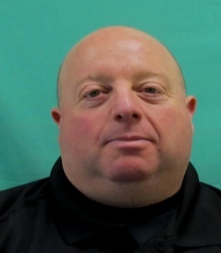
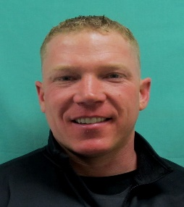
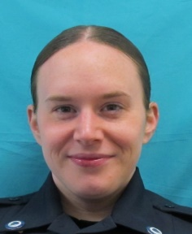
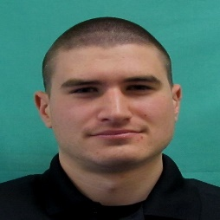
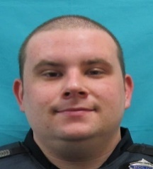
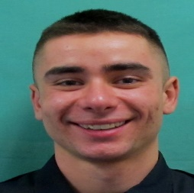
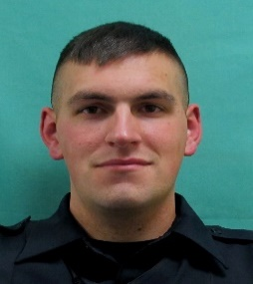
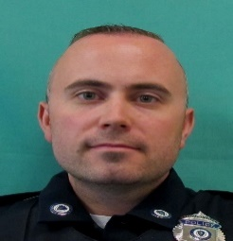
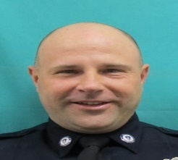
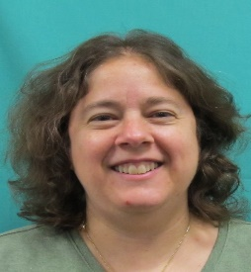
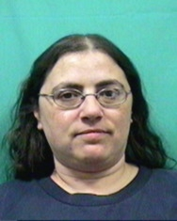
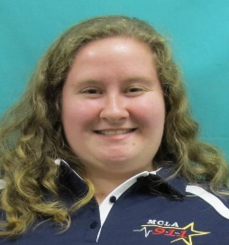
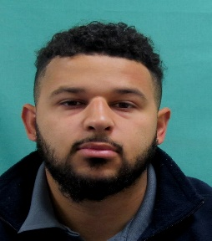
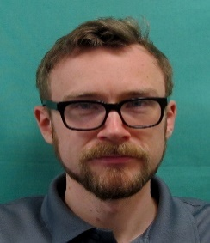
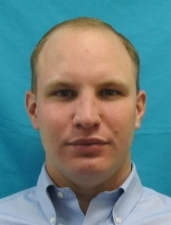
Chief of Police
Daniel Colonno
Sergeant (Day / 8a-4p)
Justin Biasin
Sergeant (Evening 4p-Mid)
Peter Urbanowicz
Sergeant (Overnight 12mid- 8a)
Mark Denault
(flex shift)
Officer
Bob Horne
Officer
Natasha Antona
Officer
Michael Cogswell
Officer
Cody Alvarez
Officer
Gary Van Bramer
Officer
Sam Hungate
Officer Chris Lampiasi
Part-Time Officer
Robert Krzanik
Office Manager
Janice Dzbenski
Dispatcher
Rosetta Sherman
Dispatcher
Christy Lemoine
Dispatcher
Khalil Paul
Dispatcher
Ryan Frazer
Part-Time Dispatcher
Ryan Kunzmann
Revised 6/14/18

Slide 15
Please do not hesitate to contact (call or stop by) your campus police department!

