Slide 1
Billing webinar
Tuesday, july 28, 2020

Slide 2
Overview of billing
Bills were mailed and eBilled (to the MCLA email address) on July 20 with an August 21 due date.
The email of the eBill includes important information and instructions on what to do.
Bills show the mandatory tuition and fees, as well as room and board (if applicable.)
Bills will also show any financial aid, deposits, payments, or waivers.

Slide 4
What should I do with my bill?
Included in every paper bill is a Billing Checklist, which goes in order how you should tackle your bill.
This Billing Checklist is on the Student Accounts website.
We will go over this list in the next slides.

Slide 5
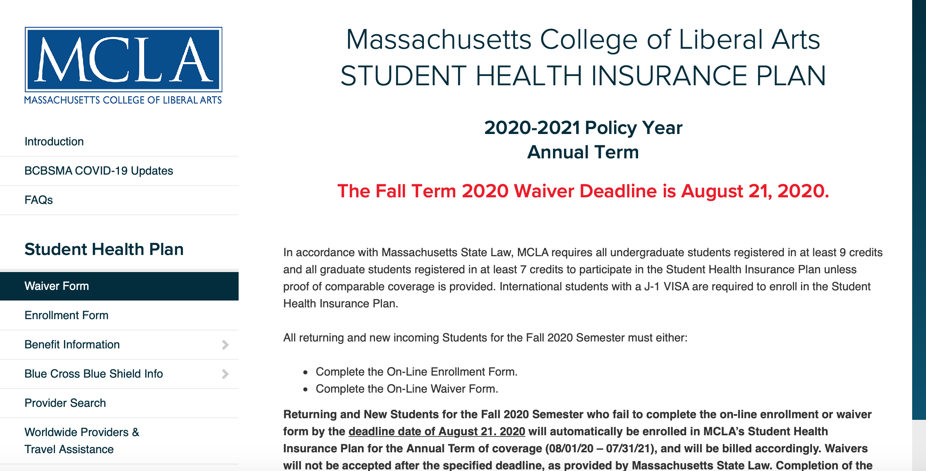
Step 1: Make a health insurance decision
Massachusetts requires students registered for 9 or more credit hours to have adequate health insurance.
Students must complete a waiver or enrollment form once each academic year if they meet this requirement.
You can waive or enroll on MCLA.edu/StudentAccounts by clicking "Student Health Insurance Waive/Enroll"
After answering questions about coverage and entering info, waivers are processed within 24-48 business hours.

Slide 6
Step 2: complete a ferpa form
Due to FERPA regulations, MCLA cannot release account information to anyone but the student.
To allow us to discuss billing or financial aid to someone beside the student, a FERPA Information Release is required.
Completed FERPA Information Releases remain effective throughout continued enrollment but may be rescinded at any time.
Students can complete or rescind a FERPA by going to MCLA.edu/StudentAccounts and clicking "FERPA Information Release."

Slide 7
Step 3: verify completion of financial aid
A completed FAFSA must be on file in order for a student to receive any financial aid, including Federal Student Loans.
The Department of Education may require additional verification documents if selected.
First time Federal Student Loan borrowers must complete Entrance Counselling and a Master Promissory Note before loans will show as a credit on the account.
Contact Student Financial Services if there is no aid on the account, but you believe there should be.

Slide 8
Step 4: complete intent to attend mcla form
In addition to satisfying the bill by the due date, Student Financial Services requires that all students respond to their bill, even if they do not owe a balance.
Students electronically respond to their bill on Banner Self Service by clicking "Student," then "Student Account," followed by "Respond to my Bill Now."
A .pdf version of the form is available at MCLA.edu/StudentAccounts.
These forms show us that you plan to come back and how you plan to pay your bill.

Slide 9
Step 5: Pay your bill / make acceptable arrangements
Payment options include:
Online payments via ACH or debit/credit cards (fee free)
Check or money order mailed to MCLA Student Financial Services (fee free)
3 or 4 Month Payment Plan through Nelnet at MyCollegePaymentPlan.com/MCLA
Alternative student loans (credit based)

Slide 11
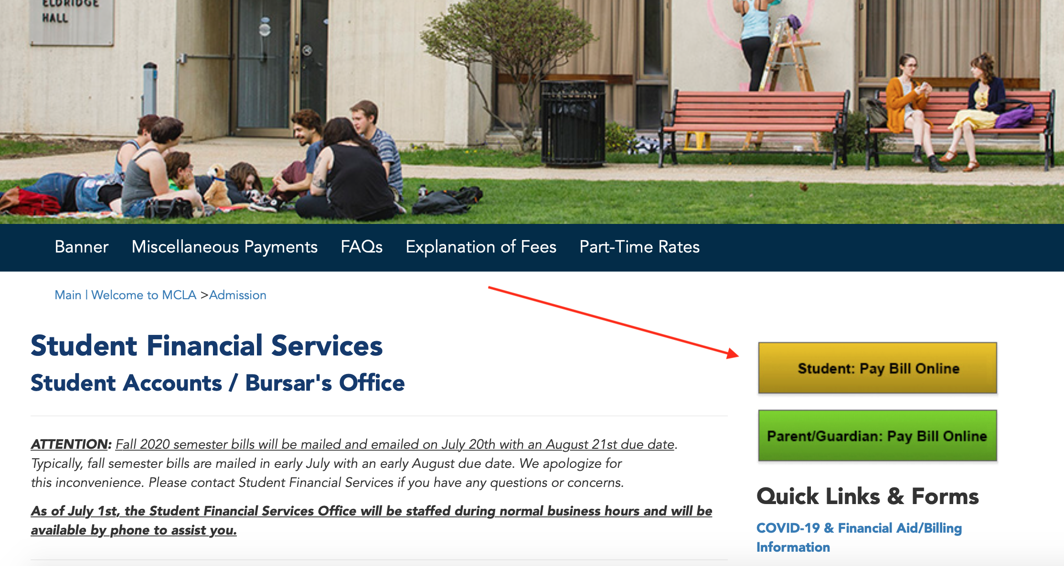

Slide 12
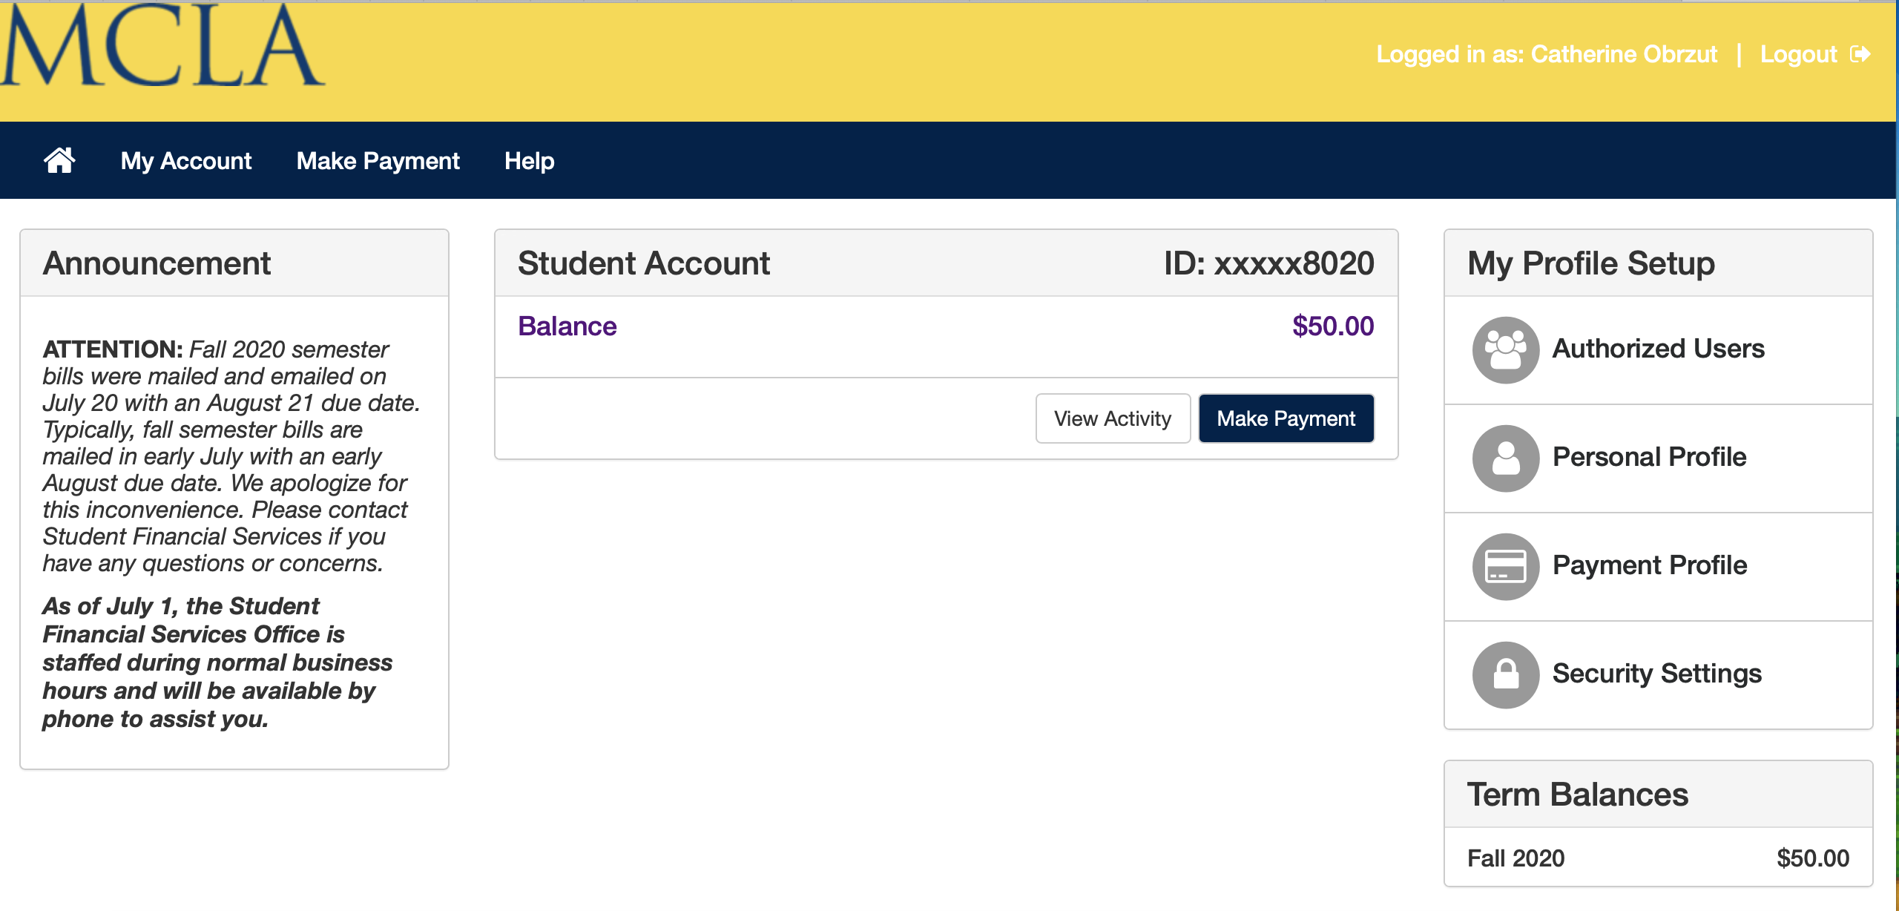

Slide 13
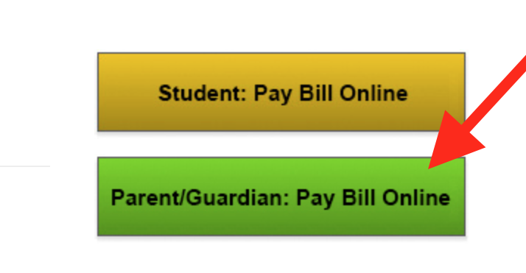
Authorizing a user to pay online
A student may authorize a non-student to make payments toward their account.
To authorize a user, students must access the Online Payment Page, then click "Authorized Users."
Students can view, add, or remove authorized users on this page.
After a student enters the valid email address, the new user will be sent emails to set up their account.
Authorized users will log into the payment page on MCLA.edu/StudentAccounts.

Slide 14
Questions?

