Slide 1
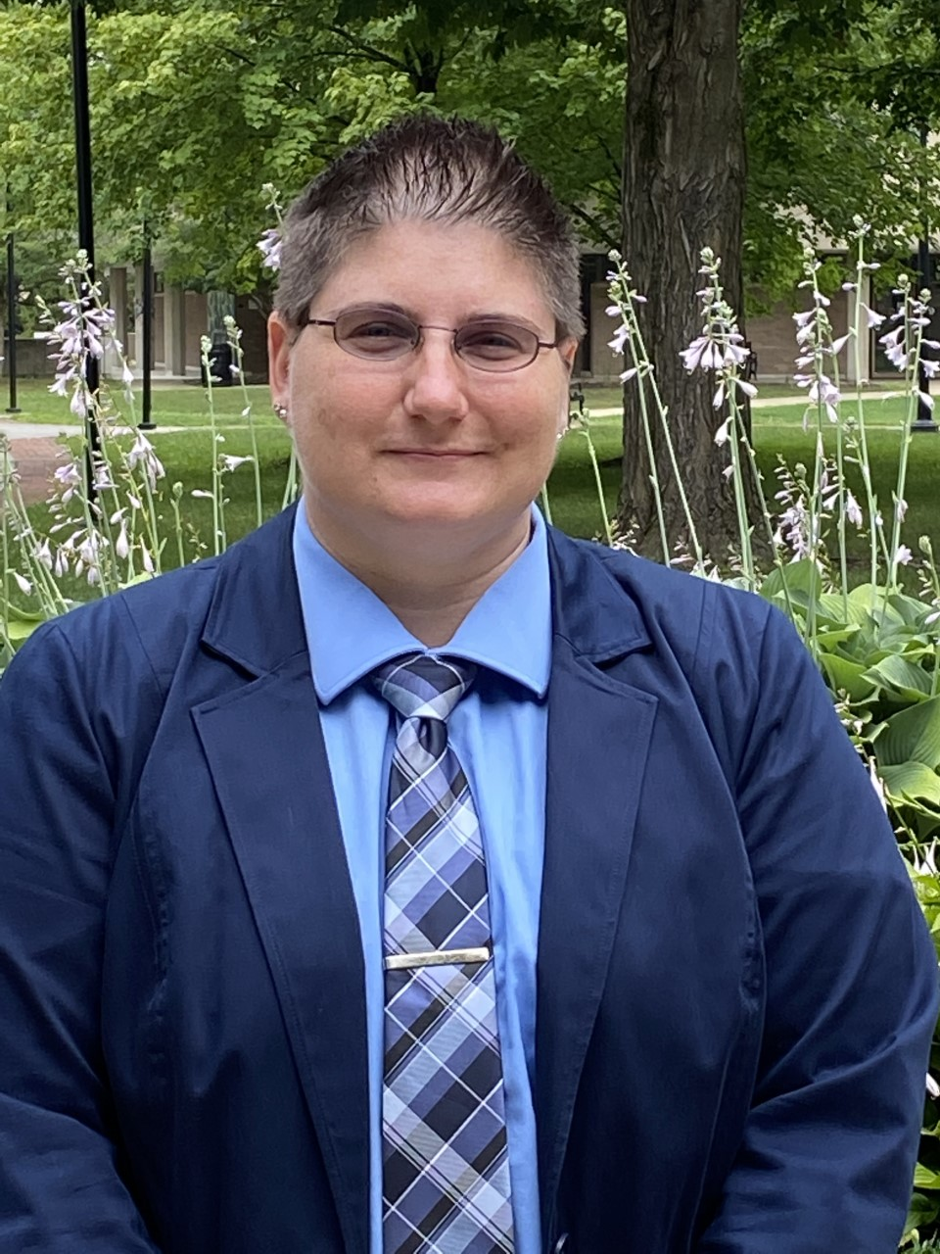
An Introduction to the Student Conduct Program
Heather Quire M.S. Ed. Dean of Students

Slide 2
Introduction to the Student Conduct Program
The Student Conduct Program is the process in which we work with students about choices, decision-making, and actions in an educational and developmental way to be successful individuals in our community.
Every student is held accountable to the community standards that are the MCLA College Policies (found in the Student Handbook).
This presentation gives a summary overview of the Student Conduct Program. For all information related to the Student Conduct Program please review the Student Handbook.

Slide 3
Let's review the Student Conduct Program
MCLA Student Conduct Program Mission
The MCLA Student Conduct Program is committed to fostering an inclusive campus community that promotes active and responsible citizenship through an educational and developmental process that values respect, responsibility, and accountability for all members of the MCLA community.

Slide 4
The Student Conduct Program Goals
Promote a consistent, fair, and timely student conduct process that encourages participation of the campus community while holding students accountable for their choices.
Educate the campus community about student’s rights and responsibilities as a member of the MCLA community.
Assist students in seeking out resources for learning and living that enhance the student’s overall well-being and help students think critically in their decision-making.
Facilitate on-going comprehensive conduct related training for students, staff, and faculty that are involved in the student conduct program.
Develop and maintain a comprehensive assessment strategy regarding all aspects of the student conduct program and engage in regular assessment of the student conduct program to aid in informed decision-making about policies, procedures, and overall community engagement of the student conduct program.

Slide 5
MCLA Student Conduct Program Outcomes
As a result of going through the student conduct program, students will be able to:
Explain
Explain why College policies exist and why the College community is concerned about their choices.
Understand
Understand the impact of their behavior and decision-making on themselves and the community.
Communicate
Communicate their personal responsibility for their behavior within the College community.
Identify
Identify ways to address their actions(s) so that their choices do not negatively impact their educational goals and success in the future.

Slide 6
MCLA Student Conduct Program Philosophy and Principles of Community
The student conduct program at MCLA is to be developmental and educational in nature and not intended to punish students; rather, it exists to protect the interests of the campus community and to challenge those whose decision-making is not in accordance with MCLA policies and to align choices to be a positive member of the community. Outcomes are intended to educate and challenge student’s ethical decision-making and align with the values of the MCLA community.
As a member of the MCLA community, members are to be respectful, responsible individuals who are held accountable for their choices and actions. All members of the faculty and staff strive to create and support an educational environment that promotes student growth and development.
The College recognizes the rights of all individuals to express themselves in works and actions and encourage civil discourse so long as they do so without infringing upon the rights of others or violating the policies outlined in the Student Handbook. There must be a willingness and commitment among all individuals in the MCLA Community to associate in a way that allows individual freedom, rights, and privileges to coexist with reasonable order. Members of the College community assume a respect for these basic principles that enable the College to accomplish its mission.

Slide 7
Statement of Evidentiary Standard of Responsibility
Students should be aware that the Conduct Review Process is different from criminal and civil court proceedings. The Conduct Review Process is not based on, nor is it intended to mirror, the rights or procedures in civil or criminal court proceedings. The Conduct Review Process procedures are intended to be fair, but does not include the same due process protections afforded by the courts. The decision of responsibility is based on the “preponderance of information,” which means it is more likely than not that a policy violation occurred and any outcomes will be proportionate to the severity of the violation and to the cumulative conduct history of the student.

Slide 8
Student Conduct Program Student’s Rights and Responsibilities
The following student’s rights and responsibilities are granted to all students going through the Student Conduct Program and who have been charged with an alleged violation.
The right to be treated with respect, dignity, and compassion by College officials and by all persons involved in the Conduct Review Process.
The right to have the opportunity to review all college policies. A student is responsible for knowing all policies as listed in the Student Handbook, including those that may occur through encouragement or neglect.
The right to be informed by written notice, delivered electronically, of the alleged violation(s) and also the date, time, and place of the meeting/hearing.
The right to review documentation and respond to the information in documentation presented at the time of the meeting/hearing.
The right to participate in the meeting/hearing or remain silent. If the student chooses to remain silent, the conduct review process will move forward.
The right to have the level of responsibility determined based on “preponderance of information” standard, which means it is more likely than not the violation occurred.
The right to request an appeal on the finding(s) and/or outcomes(s) issued based on the appeal criteria. Appeals may only be granted if at least one of the two specific criteria are met. (See Appeal Process section)

Slide 9
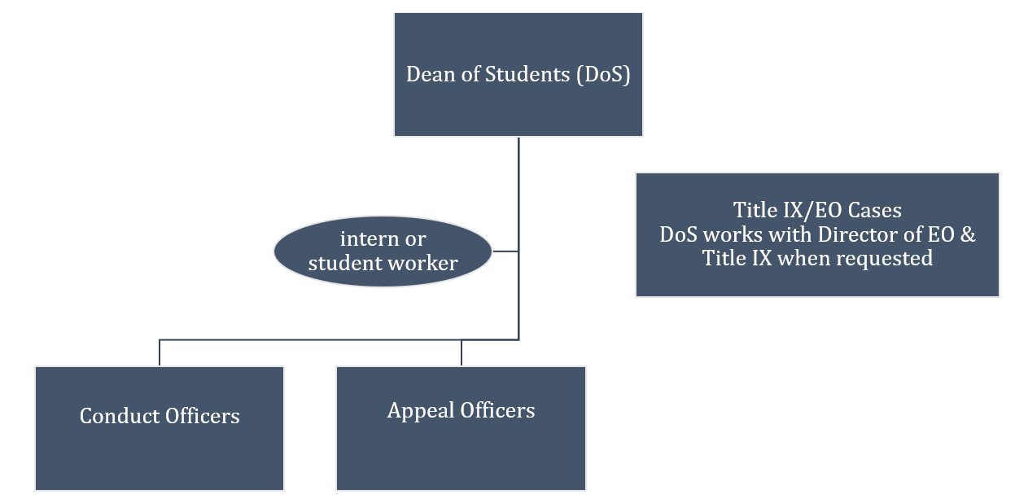
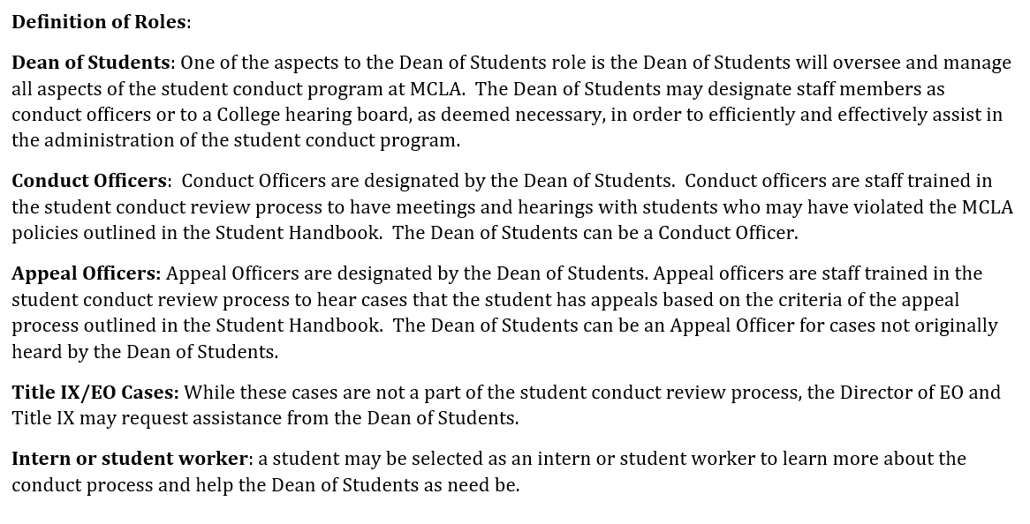
Roles in the Student Conduct Program

Slide 10
The Conduct Review Process
The path of a case will be determined by the Dean of Students.
Filing a Report
Review of Report
Interim Measures
Preliminary Meeting
Types of Case Resolutions

Slide 11
Types of Case Resolutions
Informal Resolution
Letter of Reprimand
Conduct Review Meeting
Administrative Hearing
College Hearing Board Hearing

Slide 12
Steps in the Conduct Review Process
1. Notice
2. Attendance
3. Meeting/Hearing
4. Finding and Outcome
5. Notice of Outcome
6. Appeal

Slide 13
Types of Outcomes
A few examples of disciplinary Standing:
A few examples of educational outcomes:
College Warning
Residence Area Probation
College Probation
Alcohol and Other Drug Level System (AOD Level)
Fire Safety Level System (FS Level)
Suspension from College
Expulsion from the College
Educational Online Module - Judicial Educator
Community Service hours
Special Project, Assignment, or Presentation
Reflection Paper
Restitution
Campus Restriction or Loss of Privileges
Parent/Guardian Contact

Slide 14
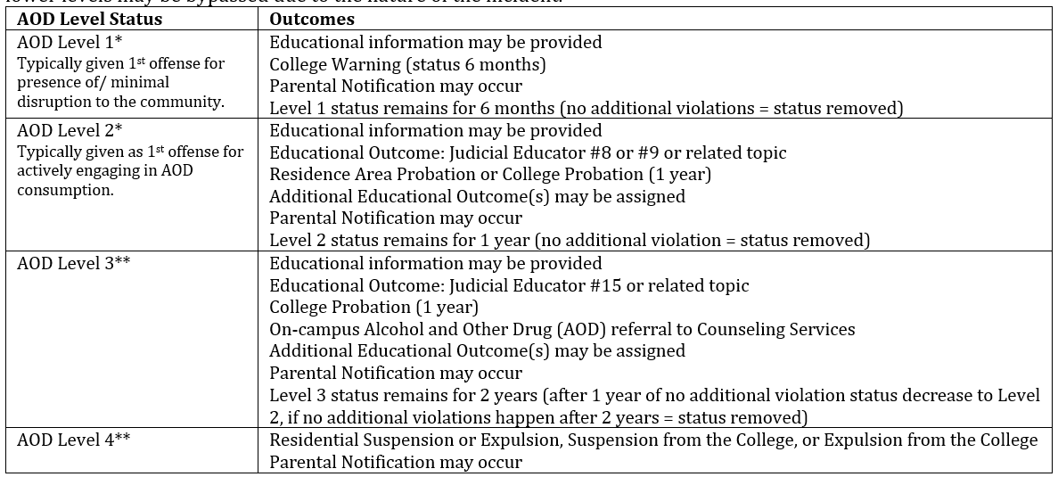
New AOD Level System
Alcohol and Other Drug (AOD) Level System: MCLA is committed to taking specific action in cases involving alcohol and/or drug violations. This Alcohol and Other Drug Level system is progressive however there are instances where lower levels may be bypassed due to the nature of the incident.
A first incident in which medical treatment/transport may result in automatic placement on Level 2. Any additional incident in which medical treatment/transport may result in level increase of levels if already on a level.
* If campus police charge a student with a citation for an appearance in court for alcohol or drug related violation, an automatic placement on Level 2 or higher.
* Off-Campus Police/Authorities are involved may result in automatic placement on Level 2 or higher.
** Drug Sale &/or Distribution may result in automatic Level 3 or Level 4.
NOTE: One part of the College’s compliance with the 1989 Drug Free School and Campuses Regulations (Drug-Free Schools and Communities Act, Public Law 101-226) and the policies of the Massachusetts Department of Higher Education is to set alcohol and illegal drug conduct code standards. In response to findings of code violations, the College will typically apply a minimum mandatory sanction. As minimum and mandatory these outcomes are aimed to provide an opportunity to examine one’s choices in light of complying with College standards as well as the Federal and State mandates and serve as a deterrent to future violations.

Slide 15
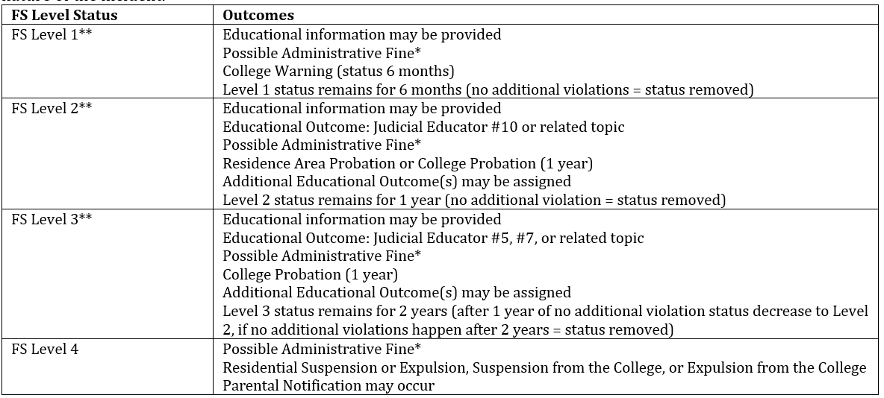
New Fire Safety Level System
Fire Safety Level System: MCLA is committed to taking specific action in cases involving fire safety violations, which include covered smoke detectors, tampering with fire safety equipment, and or smoking/vaping in buildings. This Fire Safety Level system is progressive however there are instances where lower levels may be bypassed due to the nature of the incident.
* Administrative Fine: For every covered smoke detector in a room or apartment, each person found responsible will be charged an administrative fine of $100. This administrative fine will increase $100 for each time a student is found responsible for a covered smoke detector. Covering a smoke detector puts the lives of those living in the room, floor, apartment, block, and/or building as risk and is a serious offense – this fine is meant to be a deterrent to not put the safety of other students at risk.
** If campus police charge a student with a citation for an appearance in court for fire safety related violation, an automatic placement on Level 2 or Level 3.

Slide 16
Appeal Process
The College has implemented procedures for students to appeal. Appeals are not re-hearing of the facts of the case, but rather an examination of the procedure and/or outcome. General dissatisfaction with the outcome of a conduct case or an appeal for mercy is not an appropriate basis for an appeal. The outcomes(s) resulting from a case decision will be considered on hold until the decision is affirmed, modified or reversed in the appeals process. Additionally, only a student who has participated in the conduct review process and has been found responsible for violating a policy may file a written appeal. If a student fails to attend a meeting/hearing, that student forfeits their right to appeal the decision rendered by the conduct officer or conduct board.
The possible criteria for an appeal are:
The original meeting/hearing was not conducted according to established procedures or had significant procedural errors or irregularities that denied the student(s) a fair meeting/hearing.
The student has new information that was not reasonably available prior to the original meeting/hearing and that information is likely to substantially changed the outcome of the meeting/hearing.

Slide 17
The Student Conduct Program
For additional information about the entire Student Conduct Program, see the Student Handbook (when it is released which is right before the semester starts)

Slide 18
Overview of the Student Conduct Program
Questions? Contact the Dean of Students Office
via email: Heather.Quire@mcla.edu

