Slide 1
Using Sensory Integration to Promote Positive Behavior
June
2020
Katrina Maffuccio

Slide 2
Why?
It’s time to do something constructive and positive to help students pave a path toward success in all aspects of their educational journey.

Slide 3
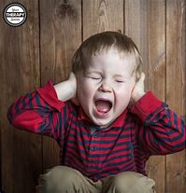
What I Noticed
Students were struggling to take in sensory information and organize it correctly.
Students would display inappropriate behavior as an attempt to solve a problem (hit, yell, cover ears, run out of room….)
The display of inappropriate behaviors require documentation (Behavior Logs) and/or time in the quiet room.
Students would become discouraged because of their own or other student’s choices and it would affect their learning, many times for the rest of the day.
Students’ brains are continuously seeking and digesting sensory information in order to keep their body regulated- this is normal. All people do this. However, students with sensory processing disorder get those sensory triggers mixed up, are unable to categorize them, need more input in order to regulate or may need less input in order to regulate.

Slide 4
The Data
Data of 34 students (September 2019 - February 2020) 669 behavior logs entered through February 2020.
Below is an example from one class.
Student | # of Behavior Logs
JA | 23
HA | 26
JB | 12
JC | 9
MF | 21
EK | 33
HR * | 13
Massachusetts Department of Elementary and Secondary Education Data
& Program Data
*Student with sensory diet and works with OT

Slide 5
What is Sensory Integration and Sensory Processing Disorder?
A bit of background and definition:
Sensory Integration and Sensory Processing at their core refer to the same primary ideas.
Sensory Integration (SI) was first proposed by Jean Ayres in 1972: “the ability to organize sensory information for use” (p.1)
Term Sensory Processing Disorder (SPD) first used by Dr Lucy Miller in 2006.
SI is about how our brain receives and processes sensory information so that we can do the things we need in our daily lives, (i.e. brush teeth, wear clothes, walk on grass, hug, climb stairs…)
SPD is when there is a dysfunction in the way the nervous system receives the messages from the senses and turns them into responses.
Dr Ayers felt that SI challenges were directly contributing to the children’s learning ability.
Notes:
Sensory processing issues are usually noticed during the toddler years. Extreme behaviors can be seen in some children who have a sensory processing issue. These behaviors include but are not limited to; screaming if face is wet, puts inedible objects in mouth (sharpener, money, pencils, erasers, rocks…), throwing tantrums around specific clothes, crashing into walls or people, unusually high or low pain threshold.

Slide 6
Types of SPD

Slide 7
Types of Processing Disorders
Sensory Modulation Disorder: A students has a problem turning the sensory messages into controlled behaviors that match the nature and intensity of the sensory information. The student will over or under react to sensations.
Sensory-based Motor Disorder: A student has a problem stabilizing their body, moving, or planning a series of movements so as to react functionally.
Sensory Discrimination Disorder: A student has a problem with sensing similarities and differences between sensations.
Students with disorders in sensory integration have inefficient processing of information received through the senses thereby impacting their educational, social, and emotional development. Their difficulties are chronic and disrupt their everyday life in a significant manner.

Slide 8
What Sensory Processing Disorder can look like…..
Notes:
Start video at 2:47 and watch until 5:30

Slide 9
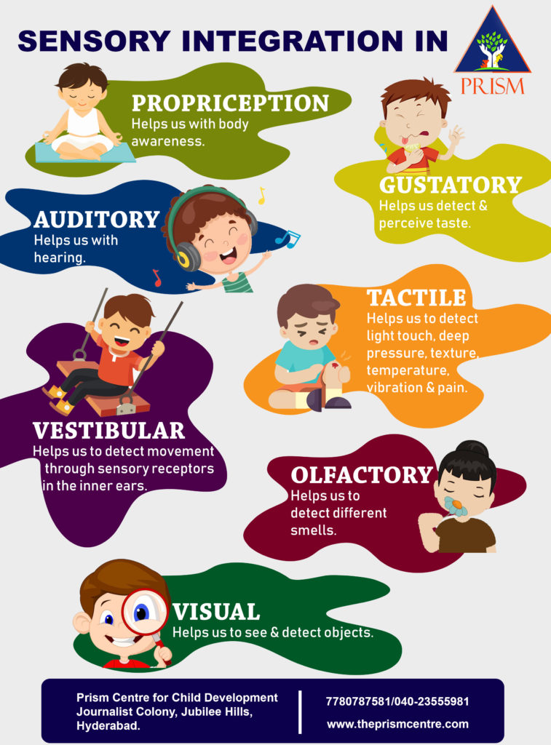
A Deeper Look
SPD may occur in each sensory system: Visual, Auditory, Tactile, Smell, Taste, Vestibular and Proprioceptive.
Symptoms will vary depending on the subtype and how many sensory systems are involved.
It is proposed that behavioral problems in children are linked to dysfunctions in sensory processing (Ayers, 1991).
Each student is unique and their sensory treatment will never look the same as another student.
https://prismchilddevelopment.com/wp-content/uploads/2019/07/final-2-757x1024.jpg

Slide 10
Seven Senses Described
Proprioceptive: This is the body awareness sense. Think personal space and the ability to understand where their body is in relationship to other things.
Vestibular: This is the balance sense. Think being able to ride a bike, walk in a straight line and understand how their body functions while being upright.
Gustatory: This is the sense of taste. Think the flavors, spices, textures and feel of food.
Auditory: This is the sense of hearing. Think how loud or quiet sounds are, where the sounds are coming from, how many sounds are being presented at one time.
Visual: This is the sense of sight. Think about how bright or dim lights are and the amount of stuff on the walls/bookcase/counters; the busyness of the room
Tactile: This is the sense of touch. Think texture, pain, temperature and feeling
Olfactory: This is the sense of smell. Think perfumes, fragrances and aromas.

Slide 11
Sensory Integration Therapy
Sensory Integration Therapy is used by mainly occupational therapists (but sometimes other health professionals) and is focused on assessment and treatment of those with SI or SPD.
Two Types of sensory therapy; Sensory diet (used daily to help system process) and intervention (change of environment to help with a particular task)
Sensory Integration Therapy can be utilized in homes, schools, community organizations, and clinics
. Sensory-based therapies involve activities that are believed to organize the sensory system, by providing vestibular, proprioceptive, auditory, and tactile inputs (The American Academy of Pediatrics, 2012).
Sensory Integration Therapy has been used with a variety of populations;
Typically developing individuals
Attention Deficit Hyperactive Disorder (ADHD)
Cerebral Palsy (CP)
Autism Spectrum Disorder
Language impairments

Slide 12
Sensory Integration in the Classroom
Over the last two years, I have worked closely with an occupational therapist to ensure that students are continuing to receive individualized sensory integration treatment (sensory diet) inside the classroom.
The students with an active sensory diet have had significant reductions in inappropriate behavioral outbursts.
I believe that the right sensory diet created for each student will help reduce the amount of behavioral outburst by teaching students to modulate, integrate, and organize sensory input and produce the appropriate behavioral responses.
*Ideally, I will continue to work with the OT to craft a tailored plan that meet the individual needs of each student.

Slide 13
OT Thoughts
Emotional outburst can be from difficulty in sensory processing. Emotional outburst, however, can have their origin in multiple arenas as well. If the person’s sensory processing needs are met this then can reduce outbursts. There is also a sensory area called “interception” that is believed to belong to the perception of the body’s physical experiences including pain, hunger, thirst, fatigue, temperature, and emotions which can have an impact on the area of emotional outburst control. – Donna, OT

Slide 14
Comparison
Two third grade students: One with and one without a sensory diet.
Student with Sensory Diet
Student without Sensory Diet
Month | Quiet Room Visits
September | 7
October | 12
November | 5
December | 0
January | 4
February | 2
Month | Quiet Room Visits
September | 20
October | 23
November | 21
December | 12
January | 21
February | 11

Slide 15
Plan
While looking at classroom and program data, I knew something needed to change in order to help students become more successful in school. I knew I could make practical changes at school and in my classroom, to help each child feel better and do better.
My plan is to create effective sensory diets that are tailored to each student’s needs and have elements that can be easily incorporated into the student’s routine.
I have developed goals, provided 4 steps to create a sensory diet, materials to collect and analyze data, activities, a sensory toolbox, and terms and definitions related to sensory integration.
Once I have completed this in my own class, I will be sharing out the data with my program, and hopefully adopting sensory integration in all classrooms.
My hope is that this plan will provide students with the strategies they may need throughout the day to help them maintain appropriate behaviors and interactions which will reduce the number of quiet room visits and behavior logs.

Slide 16
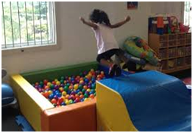
What is a Sensory Diet
A sensory diet is a program of sensory activities that students perform during the day to ensure that their body is getting the input the body needs.
A sensory diet provides activities and strategies that help students get the individual level of sensory input they need. A sensory diet should offer neither too much, nor too little input.
A sensory diet will be incorporated into all aspects of the student’s educational day.
This Photo by Unknown Author is licensed under CC BY-NC

Slide 17
Plan Goals
One goal for this plan is to help students identify their own preference and help build sufficient skills to access any and all of the sensory systems by choice, depending on what is required or would be most effective for the situation at hand.
Another goal of this plan is to enable students to participate in educational activities in a typical manner while successfully responding to challenges in his/her environment. This includes playing with classmates, enjoying and learning in school, and improving daily functions.

Slide 18
Step 1- Analyze/Identify
Step one in creating an effective sensory diet:
Identify challenges with focus or emotional regulation as a result of sensory needs
Identify the sensory related behaviors and challenges relating to sensory impairment.
In this step identification and documentation of each challenging behavior is imperative in creating an effective sensory diet.
*Observations of these challenges MUST be documented.
* Observations can be written on a piece of paper, in a Google Doc or on a Behavior Observation form (Example on next slide).
* It is important to document the observations to see if any patterns emerge.

Slide 19
Behavior Observation Form

Slide 20
How the Data Helps
The data will help identify the key elements that will be needed in effectively creating an individual sensory diet.
Key Elements:
Identify the potential challenges that are likely to occur.
Identify potential sensory activities or strategies that will address the challenges.
Incorporate appropriate sensory activities that will entice the student.
Through the implementation of a sensory diet, children with sensory processing impairments are allowed ample opportunities to receive beneficial sensory input at frequent intervals, thereby enabling him or her to participate more fully in activities that comprise his or her daily schedule. (Tools to Grow, Inc, 2020)

Slide 21
Step 2- Strategize/Reasoning
Step Two:
*Analyze the data collected from observations.
* Determine the “why” behind the observed behaviors.
*Work with OT to determine the underlying sensory needs that could be leading to the behavior.
*Strategize ways to address behaviors and sensory challenges

Slide 22
Step 3-Apply/Try Various Sensory Strategies
In this step of plan development, a variety of tools and strategies need to be tried and incorporated into a variety of the student’s settings (i.e. lunch, recess, specialist, reading).
Incorporating tools and strategies into a wide range of setting will accurately test their effectiveness.
* The effectiveness of each tool and strategy should be documented to analyze
(Sample chart on the next slide)
*To determine effectiveness, I will also analyze quiet room and behavior log data to see if any trends are developing.
Students will have access to a sensory toolbox that I will create and place in our classroom. I will also create a sensory maze for students to utilize as they enter the building, during transition, on scheduled breaks, and as they exit in the afternoon.
Children have an inner drive. Sensory integration therapy provides an environment that offers “just right challenges” that tap into this inner drive. Treatment tasks are designed to be “not too hard” (failure) or “not too easy” (boring) (Tools to Grow, Inc., 2020).

Slide 23
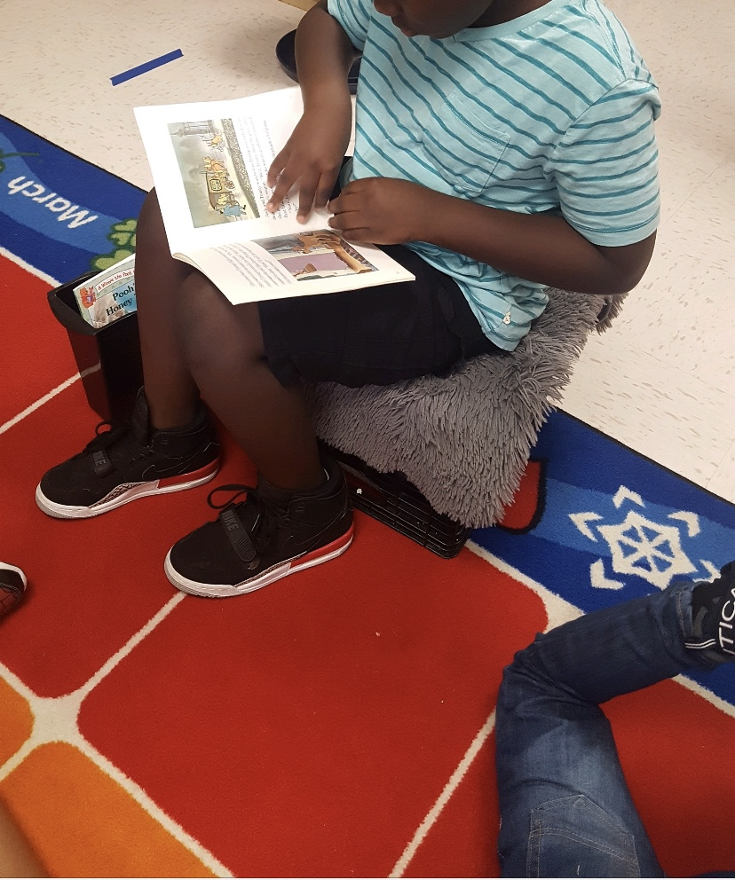
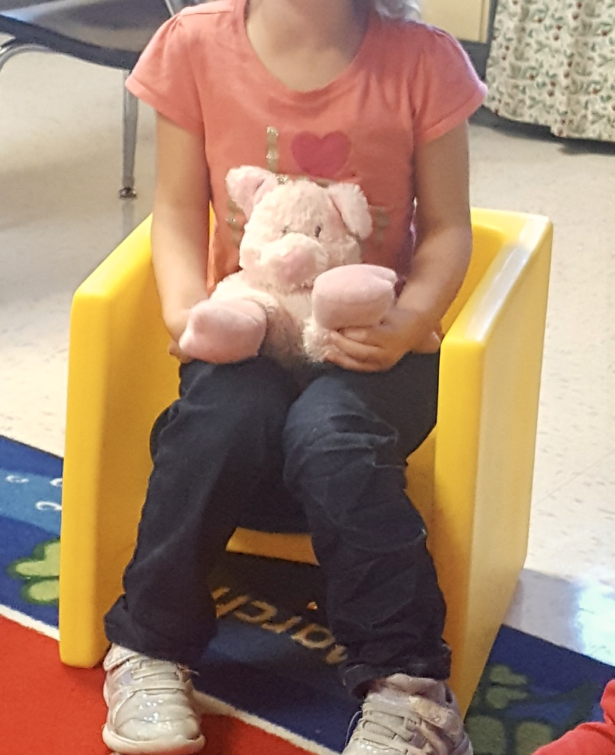
Sensory Tools In Use
Flexible seating and weighted lap animal
Flexible seating
Desk bouncy band
Standing desk

Slide 24
A Mock Schedule
Schedule | Sensory Intervention
8:35-8:40 Arrival | Sensory Maze
8:40-8:55 Breakfast
9:00-9:15 Morning Meeting/Movement | Use GoNoodle to get the body moving or centered.
9:20-10:45 ELA | Use a wobble chair
10:50-11:20 Recess | Climb on playground equipment
11:20-11:50 Lunch
11:50-12:10 Quiet Activity/Yoga | Student will follow Yoga cards
Here is what a student’s schedule might look like with a sensory diet integrated.
This child may have a sensory based motor disorder.

Slide 25
Data Collecting

Slide 26
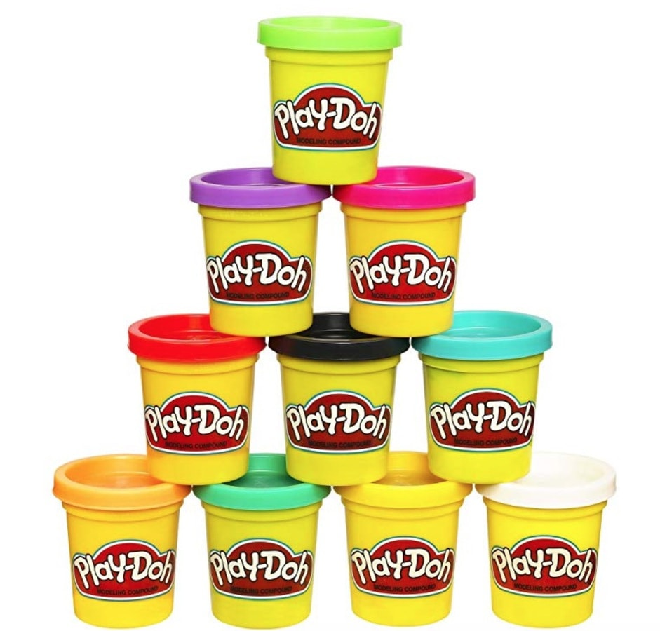
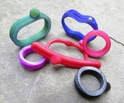
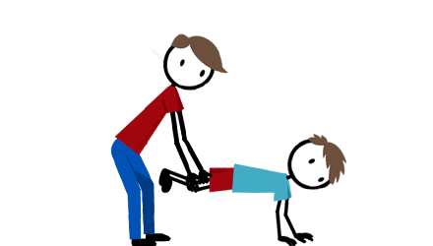
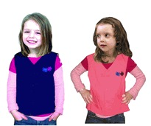
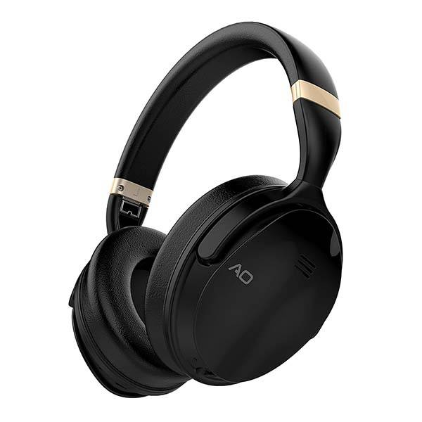
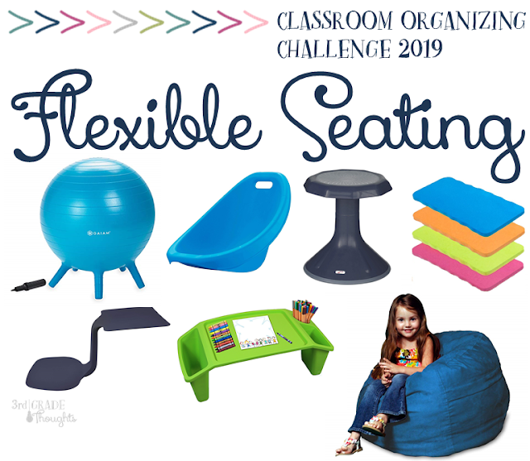
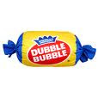
Sensory Toolbox
The toolbox will contain, but is not limited to, the items that follow; noise cancelling headphones, necklace chews, sensory bottles, weighted ball, Play-Doh, bubbles, gum, movement cards, kinetic sand, squishy ball, etc. (Each item will have a laminated card with a visual and description of how to use the tool).
Students will also have access to weighted vest, animals, blankets, wobble chairs, cushions, body socks, and other flexible seating options.

Slide 27
Example of a Sensory Maze completed by my nephew Gavin

Slide 28
Step 4-Monitor
During this final stage of development, strategies should continue to be monitored for effectiveness.
*Monitoring should happen on a frequent basis.
Collaboration with the OT is essential to ensure that each individual plan is as effective as possible for each student.
Each plan should be written out to ensure that every student is being provided with the appropriate sensory strategy.

Slide 29
Student Plan
Part of my student’s plan that I collaborated on with the OT.

Slide 30
Sensory Activities
Oral Motor
Eat crunchy food | Eat sour or spicy snack
Blow a whistle or kazoo | Use chew necklace or pencil topper
Blow bubbles | Chew gum
Blow bubbles in water with a straw | Eat gummy snack
Movement (Vestibular)
Climb stairs | Hop like a frog or on one foot
Run, jump. March, dance… | Push-ups
Play catch | Roll or somersault
Swing on a swing | Bounce on therapy ball
Play merry-go-round or use spinner toy | Do standing jumping jacks or lying-down “snow angels”

Slide 31
Activities Cont.
Visual, Auditory, and Olfactory Activities
Wear sunglasses or hat | Use calming sensory bottle
Noise-canceling headphones | White noise machine
Look at picture book | Sniff scented lip balm, diffuser, cotton balls
Move away from visual clutter | Lower or brighten lights
Tactile (Touch)
Silly putty | Play—dough
Sandbox or water table | Squishy sand, foam, or slime
Squishy or texture fidget | Use lotion
Finger paint | Knead the dough
Draw in shaving cream | Write with a vibrating pen

Slide 32
Resources to Use
Websites:
https://www.toolstogrowot.com
https://www.kidpower.org/
Books:
Sensory Integration – Michael C. Abraham
Too Loud, Too Bright, Too Fast, Too Tight: What to Do if You Are Sensory Defensive in an Overstimulating World – Sharon Heller

Slide 33
References
Ayres AJ. Sensory integration and the Child. Los Angeles, CA. Western Psychological Services; 1979
Early Warning Signs of Sensory Processing Disorder. (2018, December 9). Retrieved June 1, 2020, from https://www.youtube.com/watch?v=OBA7yQIIjis&t=1s
FREE 4 Behavior Observation Forms in PDF: MS Word. (n.d.). Retrieved June 4, 2020, from https://www.sampleforms.com/behavior-observation-form.html
Massachusetts Department of Elementary. (n.d.). 2019 School Report Card. Retrieved June 1, 2020, from http://reportcards.doe.mass.edu/2019/02360065
Morin, A. (2020, April 17). Download: Sample Sensory Diet. Retrieved June 2, 2020, from https://www.understood.org/en/learning-thinking-differences/treatments-approaches/therapies/download-sample-sensory-diet?gclid=EAIaIQobChMI-bKY47uk3AIVD0R-Ch3M_gTnEAAYASAAEgLxufD_BwE

Slide 34
References Cont.
Sensory Integration Therapies for Children With Developmental and Behavioral Disorders. (2012). Pediatrics, 129(6), 1186–1189. doi: 10.1542/peds.2012-0876
Tools and Ideas for Occupational Therapists, Teachers, and Parents. (n.d.). Retrieved June 2, 2020, from https://www.theottoolbox.com/

Slide 35
Thank You!
Katrina Maffuccio

